Slide 1









WHONGNAIMOR

Slide 2
INTRODUCTION

Slide 3
BUSINESS BACKGROUND
WhongNaiMor is a social media platform for Chiang Mai University students and personnel to share experiences, ask questions, and exchange information within a dedicated community.
Inspired by the Facebook group “ลูกช้าง มช.”, it aims to address privacy risks, limited access control, and trust concerns while making important announcements, warnings, and emergency posts easier to find.

Slide 4
BUSINESS PROBLEM
CMU community information is scattered across social media platforms, making useful content difficult to find, organize, and verify. Important announcements, warnings, and recommendations can be buried under new posts.
Without a structured database, administrators struggle to track reports, moderate inappropriate content, and prioritize important posts. WhongNaiMor needs a centralized database to improve information access and community management.

Slide 5
MOTIVATION
A centralized database will organize users, posts, comments, reactions, and reports, making information easier to search and manage. It will help administrators moderate content and prioritize important posts while helping students find relevant information.
The database will also support future improvements through usage data, making WhongNaiMor more useful for the CMU community.

Slide 6
BUSINESS RULES
AND
DATABASE MODELING

Slide 7





Objective
USERS, SCOPES AND OBJECTIVES
  Create a student-centered community platform for CMU students.
  Enable secure access through CMU accounts.
  Highlight important posts for easier discovery by filtering out inappropriate content and prioritizing them.
  Allow users to share experiences, recommendations, questions, and useful information.
Scope
  User accounts and CMU account information
  Posts, images, comments, and reactions
  Reports and inappropriate content records
  Notification
User Types
  CMU User — Log in, create posts, comment, react, ask questions, and share experiences.
  Non-CMU Users — Browse public posts and learn about student life at CMU.
  Moderator — Manage users, review reported posts, and remove inappropriate content.
Out of Scope
  Mobile application data
  External social media data
  Direct messages between users
  No account creation and personalization. (Use template accounts)

Slide 8
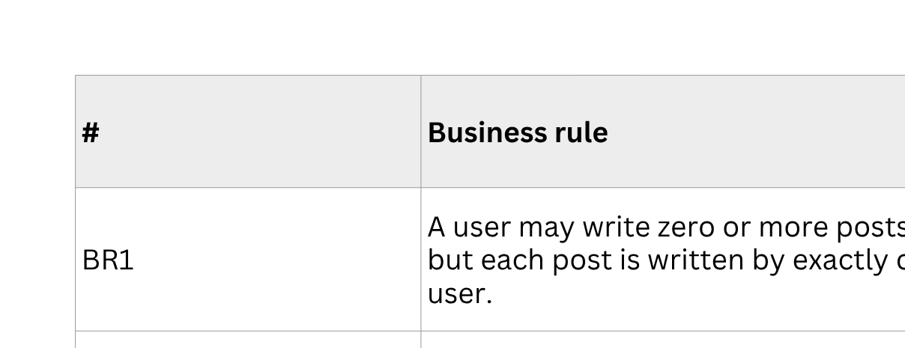

RELATIONSHIP RULES
EXAMPLE
BUSINESS
RULES

Slide 9
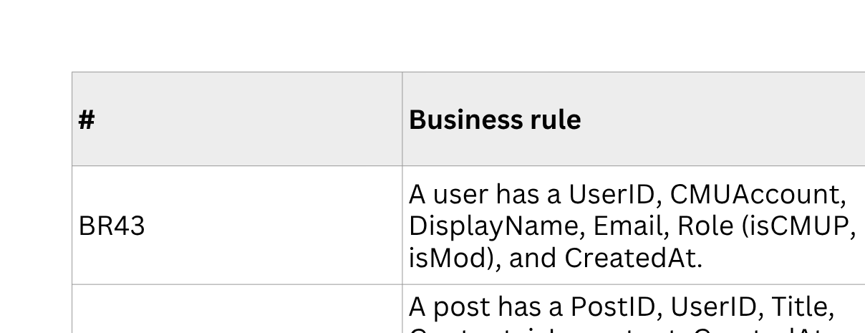
ATTRIBUTES
EXAMPLE
BUSINESS
RULES

Slide 10
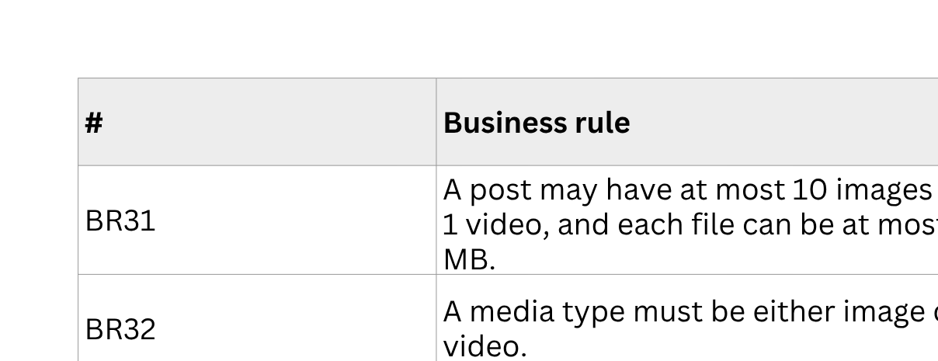
CONSTRAINTS
EXAMPLE
BUSINESS
RULES

Slide 11
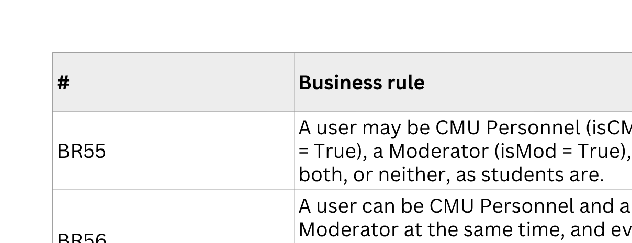
SPECIALISATION
EXAMPLE
BUSINESS
RULES

Slide 12
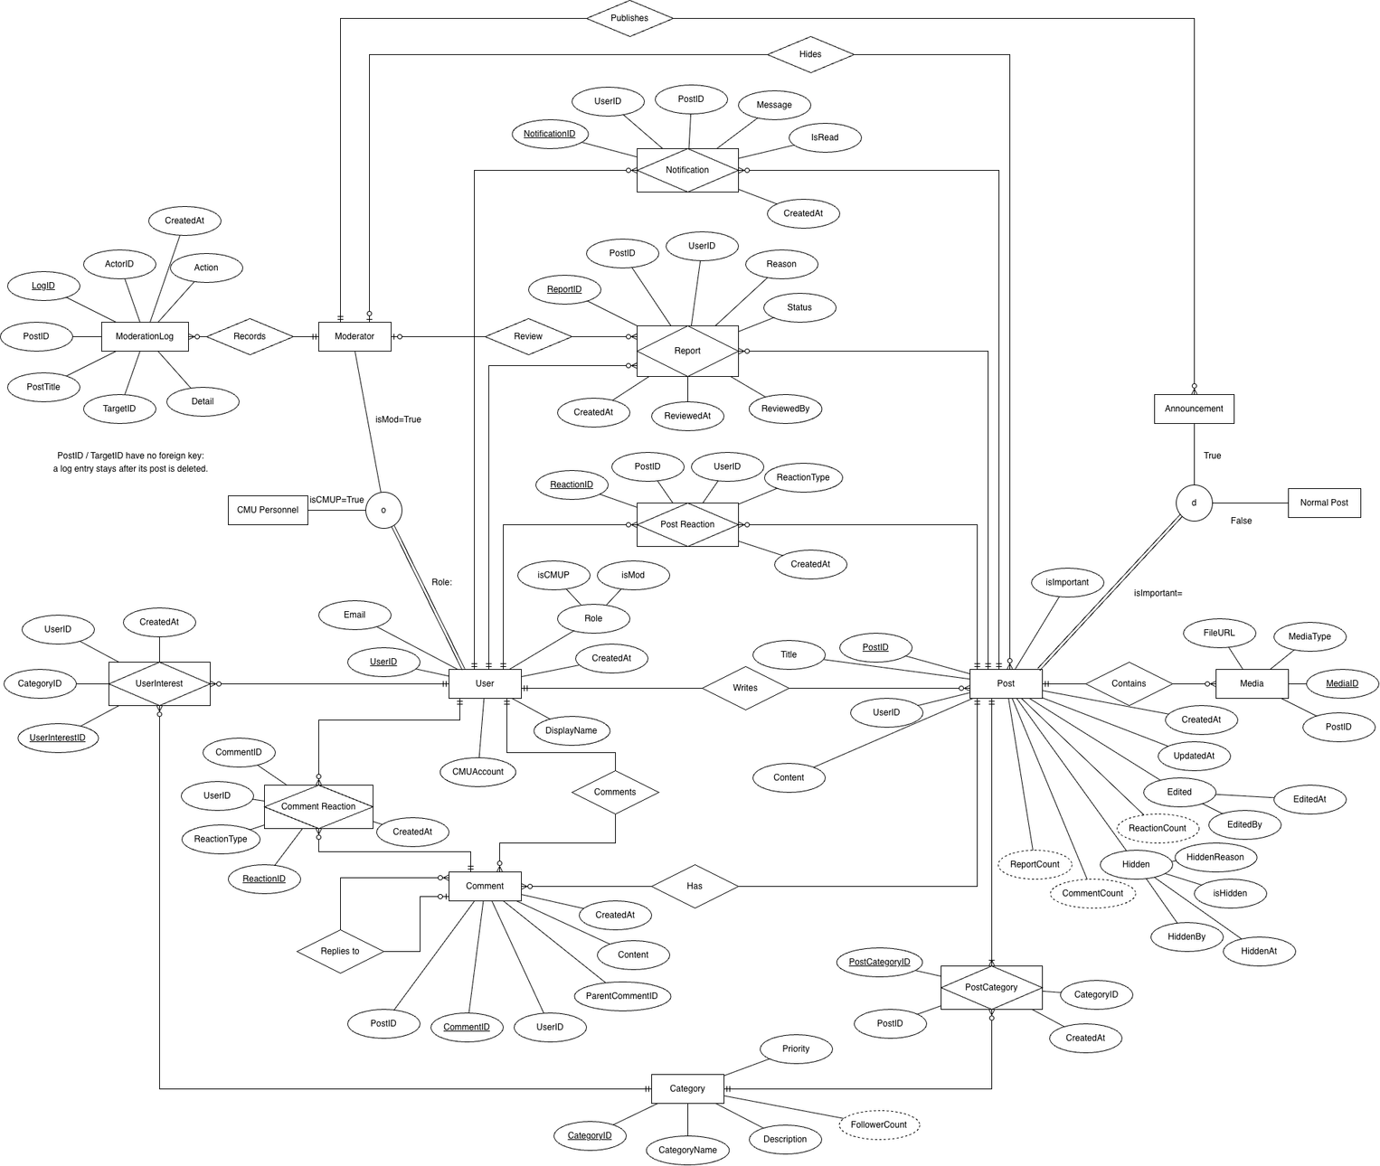
EER
DIAGRAM
Note: EER diagram is already in 3NF

Slide 13
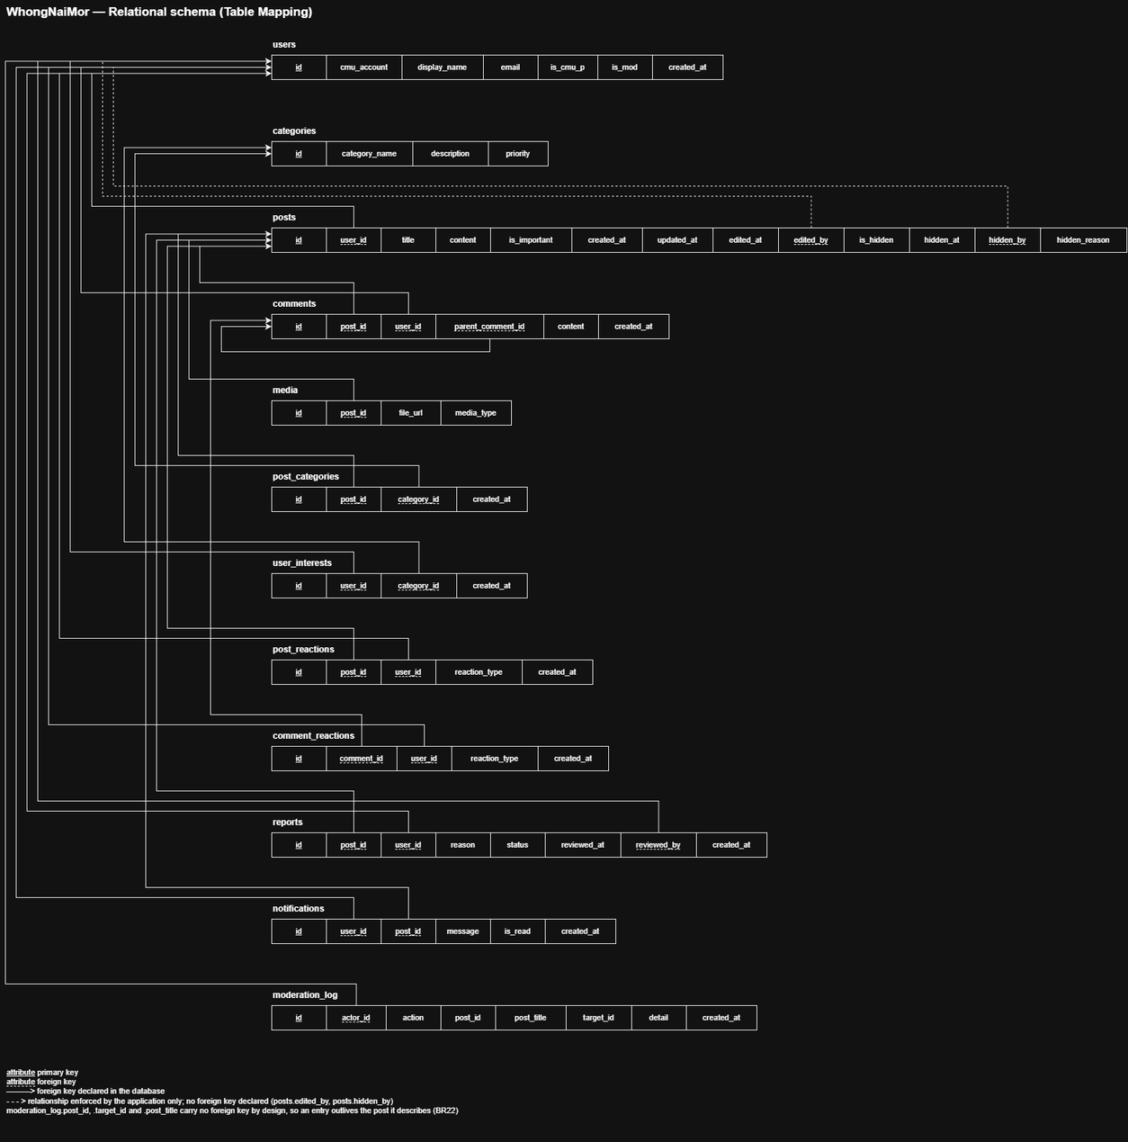
SCHEMAS
Note: The schemas are already in 3NF

Slide 14
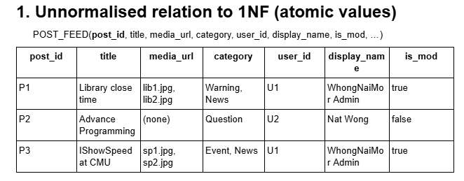
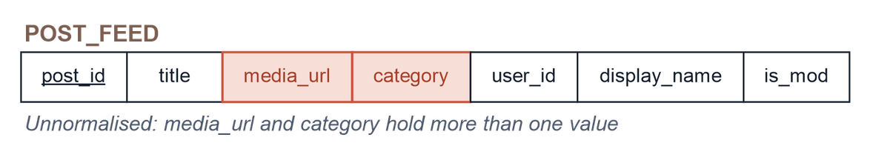
NORMALISATION
Note: This is a what-If situation because the EER and the mapped tables are already 3NF

Slide 15

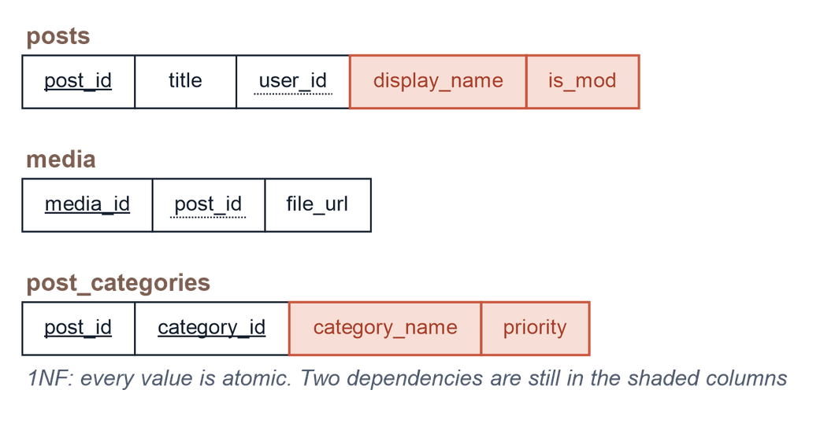
NORMALISATION
UNNORMALISED
1NF

Slide 16
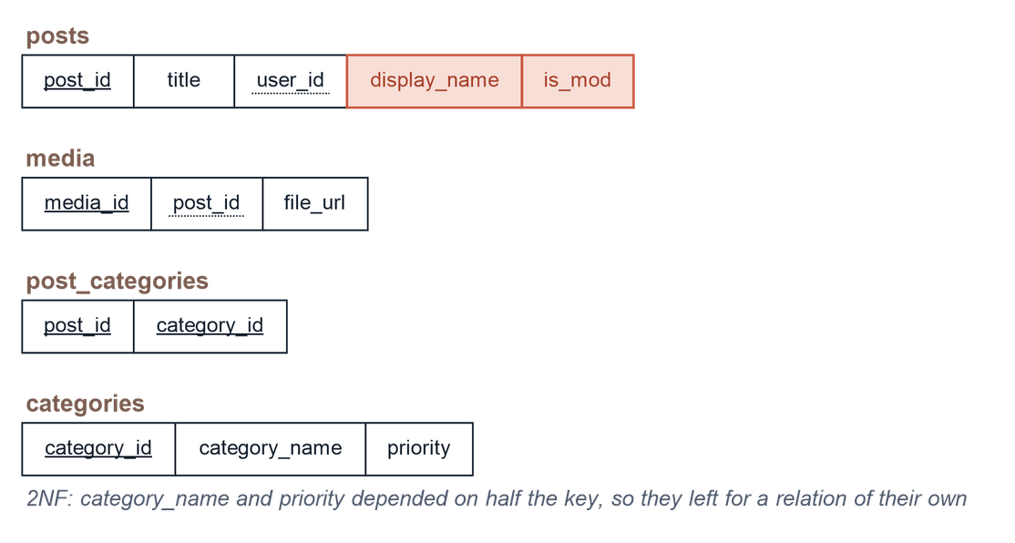
NORMALISATION
1NF
2NF

Slide 17
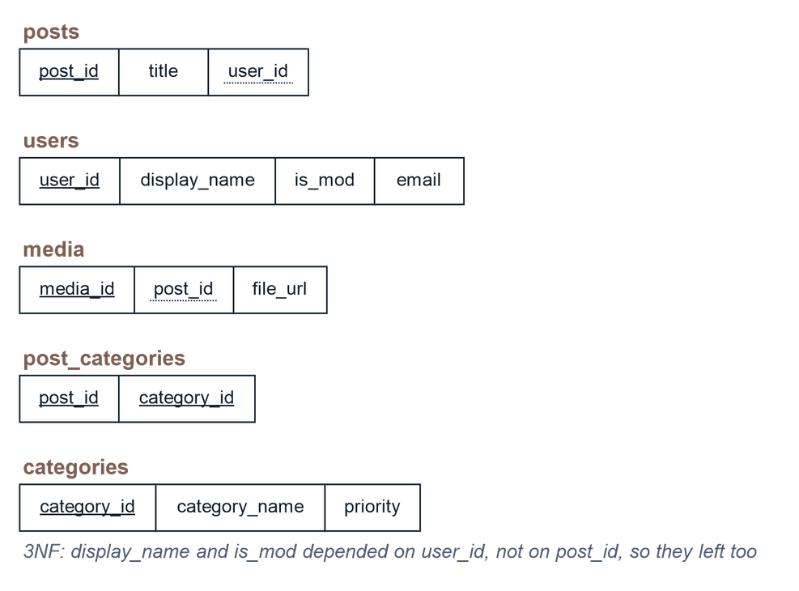
NORMALISATION
2NF
3NF

Slide 18
SQL CODE EXAMPLES

Slide 19
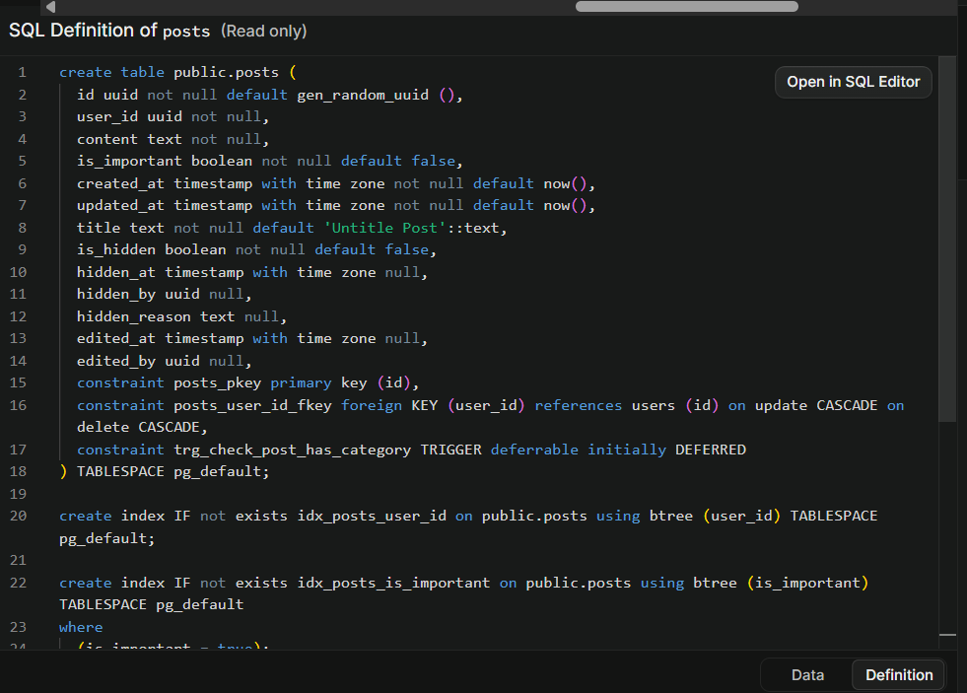
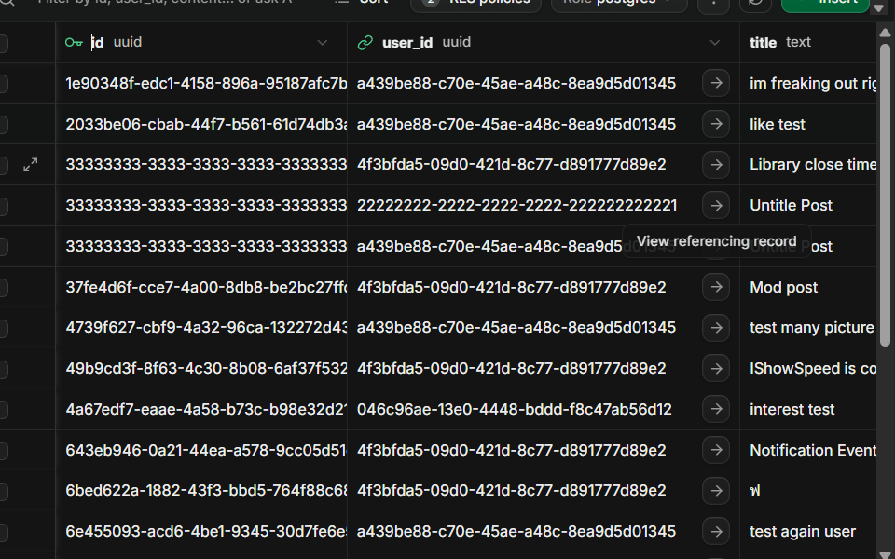
DDL - NORMAL TABLE
SQL
TABLE VIEWER

Slide 20
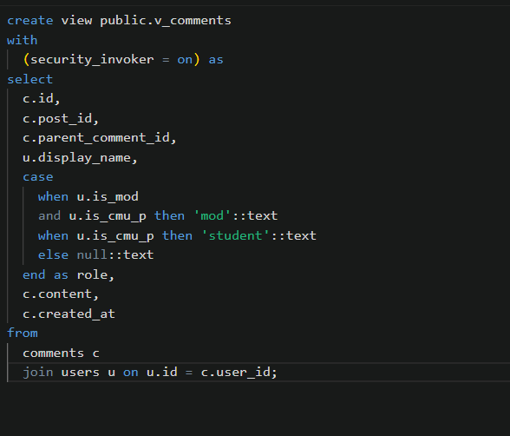
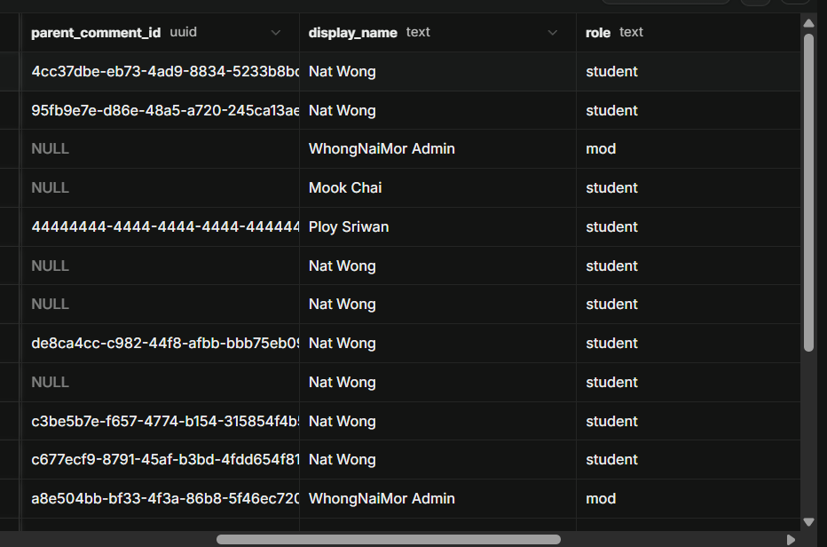
DDL - VIEW TABLE
SQL
TABLE VIEWER

Slide 21
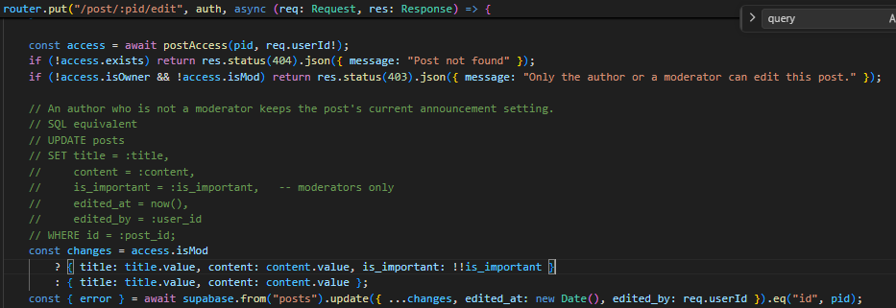
DML - SUPABASE SDK
⟵ SQL
SUPABASE SDK FUNCTION

Slide 22
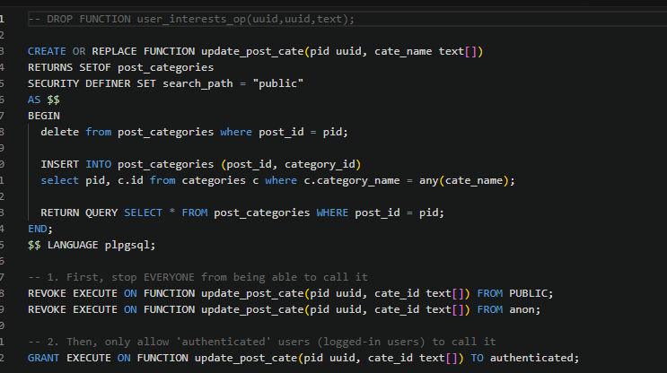
DML - RPC FUNCTION
⟵ SUPABASE SDK CALL RPC FUNCTION
RPC FUNCTION SQL
⟵

Slide 23
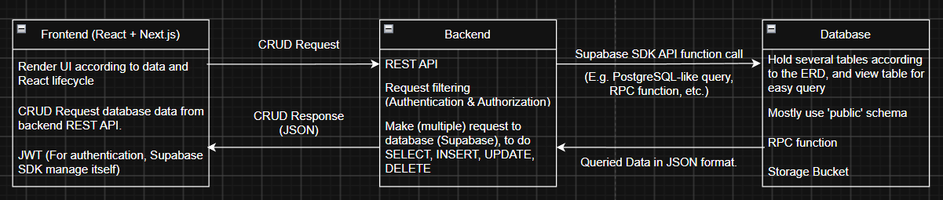
SYSTEM ARCHITECTURE

Slide 24










TECHSTACK
FRONTEND
BACKEND
DATABASE
DEPLOYMENT
VERSION CONTROL

Slide 25

Proposed Milestone
THE ACTUAL MILESTONE
8 Sep · Proposal approved — All
15 Sep · Database design — Parintorn, Thanwisit
17 Sep · Backend API — Thanwisit
18 Sep · Frontend — Natphisit
19 Sep · Integration testing — All
20 Sep· Final project — All
Milestones & Owners
8 Sep · Proposal approved — All
15 Sep · Database design — Parintorn, Thanwisit
20 Sep · Backend API — Thanwisit
23 Sep · Frontend — Natphisit
14 Oct · Integration testing — All
14 Oct · Final project — All
We couldn’t follow the proposed milestone because
  Everyone took a 1-week break
  Different understanding of the business and not communicate well enough.
  Feature creep

Slide 26
SHOWCASE TIME
Visit Here: https://whongnaimor.vercel.app/

Slide 27
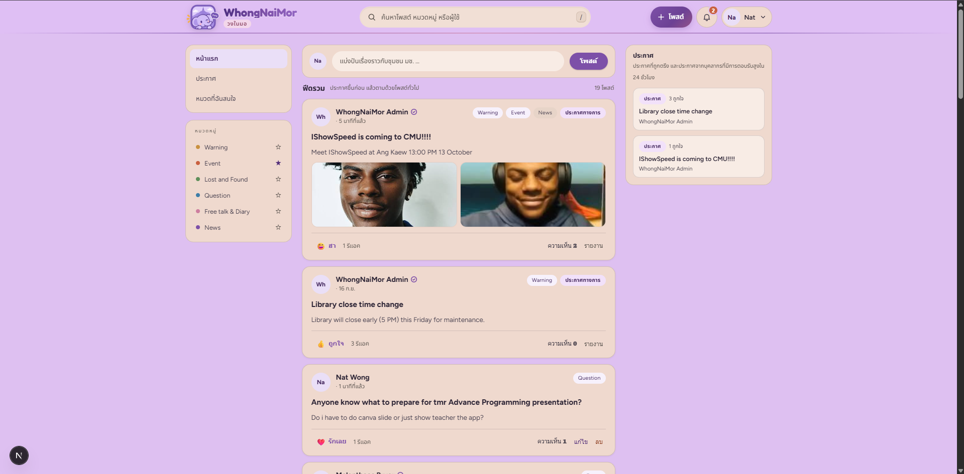
UI
EXAMPLE
&
DEMO TIME
FEED

Slide 28
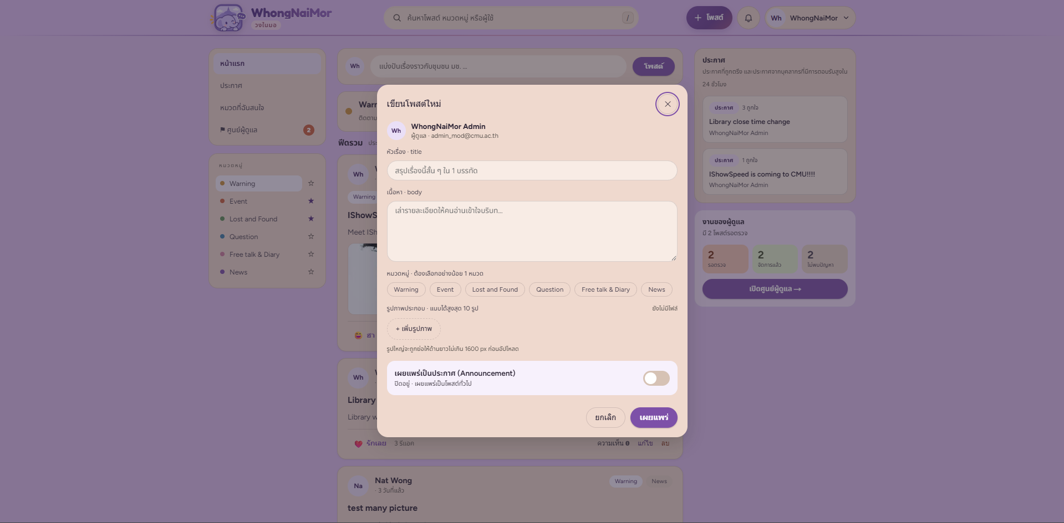
UI
EXAMPLE
&
DEMO TIME
CREATE POST

Slide 29
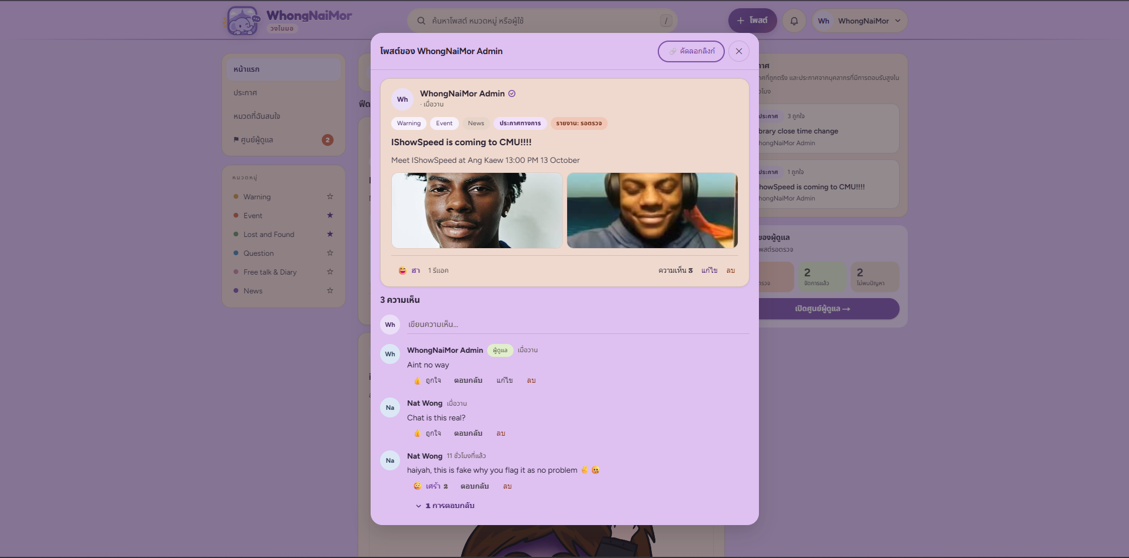
UI
EXAMPLE
&
DEMO TIME
POST

Slide 30
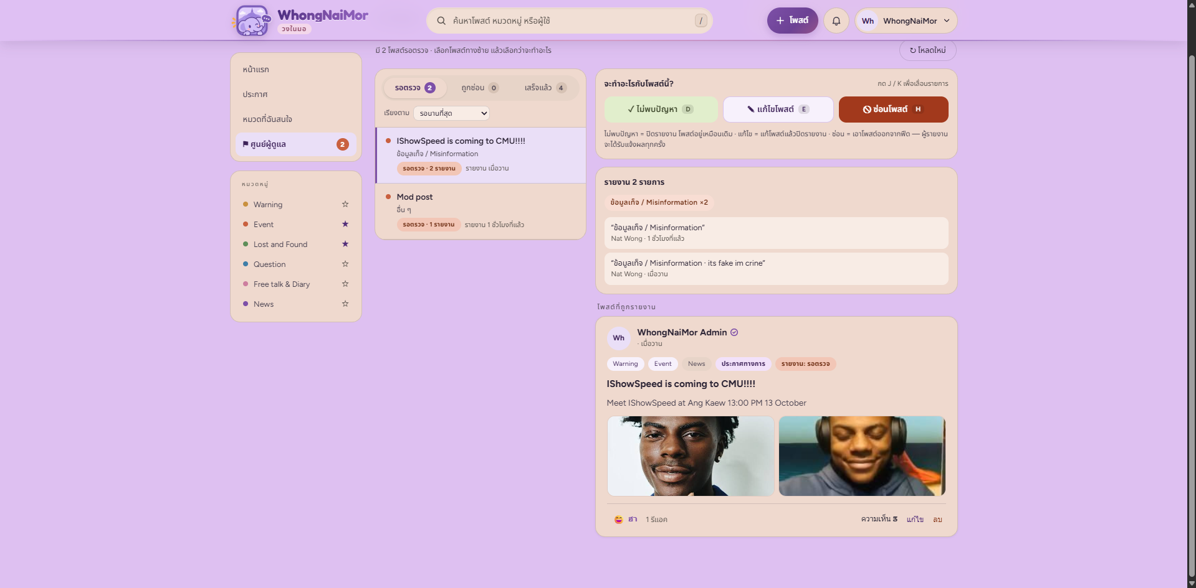
UI
EXAMPLE
&
DEMO TIME
MOD DASHBOARD

Slide 31
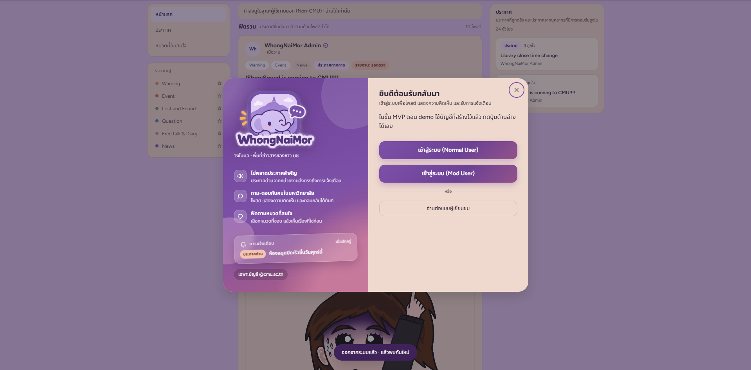
UI
EXAMPLE
&
DEMO TIME
LOGIN

Slide 32
THANK YOU!
We wish our project pique your interest!

